Slide 1
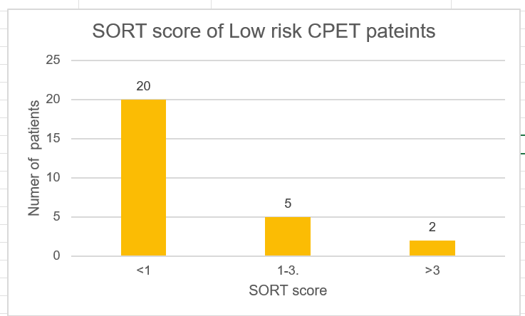
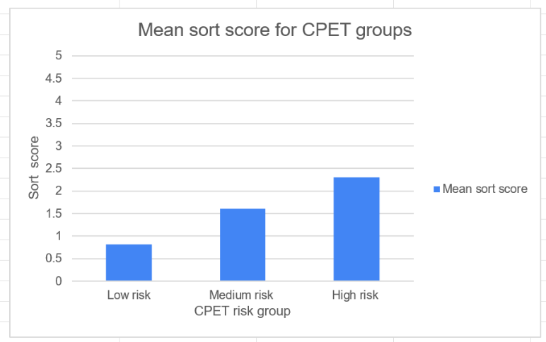
Predicting Risk and Post Operative Destination Planning
in Colorectal Surgery
Susanna Enongene¹, Dr Sara Churchill ² 1.Cardiff University School Of Medicine 2. Anaesthetic department, UHW.
Introduction
Colorectal surgery is widely performed and associated with significant morbidity and mortality.
Assessing functional capacity and using scoring system could help to stratify risk and predict complications in surgical patients .
This project was prompted by a PQIP report concerning post operative destinations and SORT scoring
Methods
We gathered data through the PQIP webtool and clinical portal.
Retrospective data evaluation from March 2019-December 2021
We reviewed data from 113 patients
We correlated CPET risk with SORT scores, post operative destinations and complications
Results
Approximately 56% of patient did not have CPET performed.
The SORT score was calculated for each patient and ranged
from 0.13- 6.89. The median SORT score in these were 0.37.
In the low-risk group those that were determined low risk by CPET criteria also had low SORT score .
5% of patients who had CPET were stratified as high risk and went to a high care area post operatively. However, the SORT score for 84% of these patients classified them as low-medium risk.
High risk patients on CPET had increased complication and length of stay.
Conclusion
This project conforms that performing CPET is more accurate than the SORT score in assessing patient risk and determining post operative complications.
Isolated SORT scoring may miss those high risk patients
CPET is not an infinite resource
There are better risk scoring tools to guide post operative destination and predict post operative complications
References
Alleway R. Surgical Outcome Risk Tool (SORT). Ncepod.org.uk. 2022. [accessed 3 Jul 2022] Available from: https://www.ncepod.org.uk/sort.html
2022. [accessed 3 Jul 2022] Available from: https://www.spineuniverse.com/treatments/surgery/what-post-operative-care
CPET – Welsh Anaesthetic Trainees Journal Club. Welsh Anaesthetic Trainees Journal Club. 2022. [accessed 3 Jul 2022] Available from: https://anaesthesiajournalclub.co.uk/tag/cpet/
NHS Wales (no date) UKHDRA. Available at: https://ukhealthdata.org/members/nhs-wales/ (Accessed: January 2, 2023).

